Slide 1
VAML Final Presentation
Wei Fan
Instructor: Matthew Berger

Slide 2
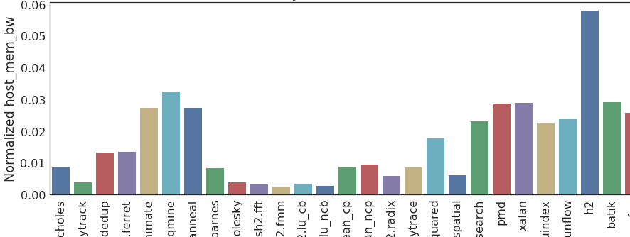
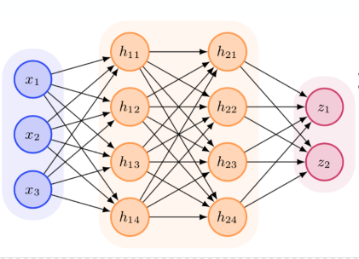
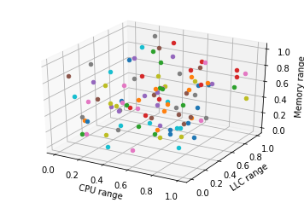


Goals
Isolation Performance Profiling of Applications
Clustering of Applications
Application Mix Resource Utilization Profiling
Building Resource Stressor Prediction Model
Building Application Mix Repository that cover the Resources Design Space Surface
Creating Design Space Exploration surface for the Resources
Building the Application Interference Model
Give insight to relation between system pressure and application performance.
OFFLINE - One Time Profiling
Step for Each Hardware
ONLINE -
Repeat for
Each New App
From FECBench paper
Notes:
FECBench is an open source framework, which guides providers in building performance interference prediction models for their services without incurring undue costs and efforts. It’s important to get a deep insight of the relation between system pressure and application performance no matter in the stage of building model or in evaluating performance for a target application. So that’s my project goal.

Slide 3
Tasks
Clear view in system pressure (provide view for high dimensional data)
Correlation between metrics
Raw data
Principle component analysis
View in performance
Relation between performance & system pressure
Time period comparison in system pressure & application performance

Slide 4
Data
From a target application
Time series
Performance
Latency90
Pressure: System metrics
System bandwidth, memory bandwidth, context switch, cpu percent, disk io, host memory, host network etc.
Notes:
The data is about system pressure and performance of a target application. There are about 300 data items per application. Each data item contains a timestamp, some important system metrics to represent the system pressure which application is suffering at that time, and the corresponding performance. We use an attribute called ‘latency90’ to evaluate the application performance, which means 90 percentile of the latency. The latency means the time it takes for a data packet be transmitted from server to client.

Slide 5



Models
PCA
First component:
Further components:
Notes:
PCA is used for reducing dimensions for high dimensional data. It is defined as an linear transformation that transforms the data to a new coordinate system such that the greatest variance by some projection of the data comes to lie on the first principal component , the second, and so on.
How does PCA work -
Calculate the covariance matrix X of data points.
Calculate eigen vectors and corresponding eigen values.
Sort the eigen vectors according to their eigen values in decreasing order.
Choose first k eigen vectors and that will be the new k dimensions.
Transform the original n dimensional data points into k dimensions.

Slide 6
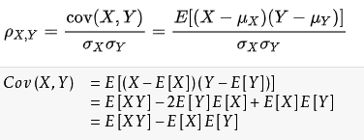
Models
Pearson correlation coefficient
Notes:
The Pearson correlation coefficient is a measure of the strength of the linear relationship between two variables. it has a value between +1 and −1, where 1 is total positive linear correlation, 0 is no linear correlation, and −1 is total negative linear correlation. In my case the variables are system metrics do we can see the correlation between them

Slide 7
Visualizations
Performance view – line chart
Correlation view – correlation coefficient factor table & inline scatter plots
Data view – parallel coordinator plot
Eigenvector view - parallel coordinator plot
Projection view – scatter plot
Principle components view – grouped barchart
Notes:
I have six views to provide a clear insight to the relation between application performance and system pressure, based on the PCA model. I’ll go through them individually.

Slide 8
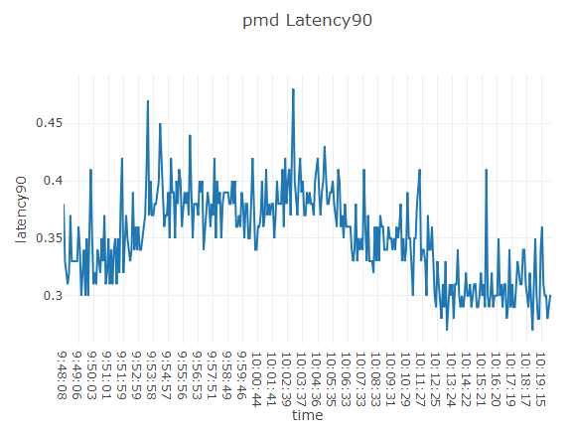
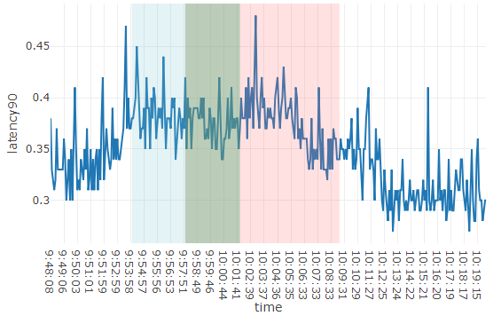
Performance view – line chart
Lib
Plotly.js + d3.js
Data
Full dataset [‘latency’, ‘time’]
Encodings
X: time series (timestamp)
Y: latency (performance)
Background color: range selected
Interactions
Range selection/cancel. Overlap ranges are allowed.
Notes:
The application performance is evaluated by a single metric, latency. And the dataset is a timeseries dataset, so using a linechart is a good way to give insight to performance. The data encoded here is the time and latency attribute from the raw dataset. X axis is time, Y axis is latency. User can drag ranges for comparison because you can see there is some time period with high latency, and some are low so it’s important to allow user to compare with these intervals to see what happens. And the ranges they select are marked with different background colors. Selecting time periods influences all plots so I’ll go through it later.

Slide 9
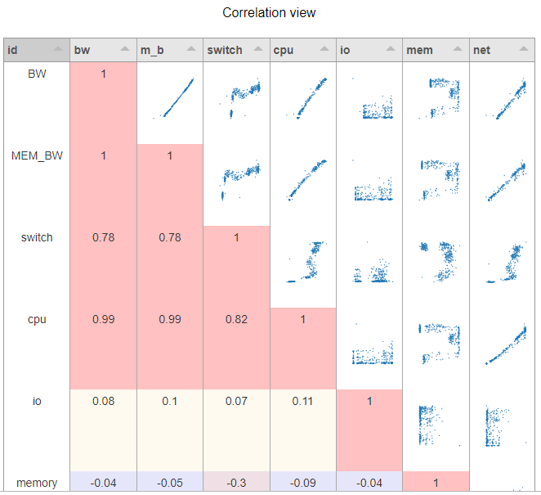
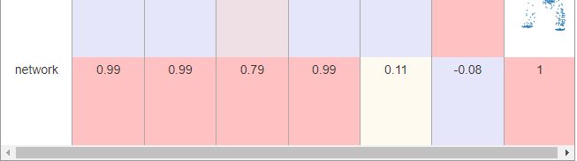
Correlation view – table + inline scatter plots
Lib
Tabulator + plotly.js + d3.js
Data
Person correlation coefficient value on the selected ranges
Encodings
Table
Row/column: system metrics
Cell value: Person correlation coefficient value + inline plots
Cell color: coefficient value.
Color scale: cold/warm colors. (cold color: <0; warm: >0)
Inline plots
X: row metric
Y: column metric
Interactions
Be linked with performance view
In-graph: zoom
Notes:
This is the correlation view, which uses a table with inline scatter plots. The data encoded is Pearson correlation coefficient value on the selected ranges. Default is the full dataset. As you can see, the row and column are metrics and cell values are numbers and scatter plots. For the cells that contains numbers, the values are Pearson correlation coefficient value. I use cold colors for background to represent negative values and warm colors to show positive ones. The colder or warmer the cell is , the smaller or larger the value is. As for the inline scatter plot, xaxis is metric in row and yaxis is metric in column.
I draw this plot because the Pearson correlation is important in PCA and people need to know the correlation between two metrics. Inline scatter plots give a straightforward view about the correlation. This idea is from iPCA paper.

Slide 10
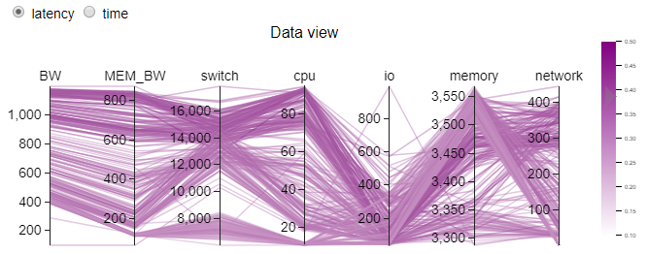
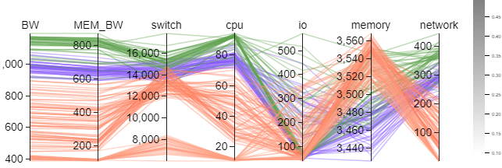
Data view- parallel coordinator plot
Lib
D3.js - parallel-coordinates(syntagmatic) && Mostapha Sadeghipour Roudsari
Data
System metrics attributes from raw dataset on selected time periods
Encodings
Coordinator: system metric
Color: latency/ time (user can choose) – gradient colorscale
Time period selected – discrete color to represent different time period
Interactions
Brush on dimension
Click on single data item – find outlier
Hover
Linked with other views
Select which attribute to be represented by color
Notes:
The data view is designed as a parallel coordinator plot. Data used here is raw data. If user select time periods on the performance plot, this data view will show selected data and use different colors to group them. The gradient colorscale, from light purple to dark purple, light red to dark red, represents the latency. And I gave a radio for user to switch this color encoding. You can change it to time attribute. And the color bar will change and be well scaled too.
I draw this because parallel coordinator plot is good for viewing high dimension raw data. I choose latency and time in gradient colorscale because you can observe something like ‘high latency is always along with high cpu precent’ or ‘with time going, the network decreases’. Because all plots are linked, I’ll go through conclusion I get from visualizations later.

Slide 11
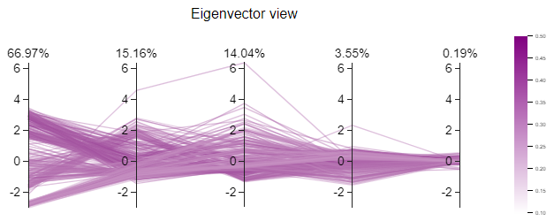
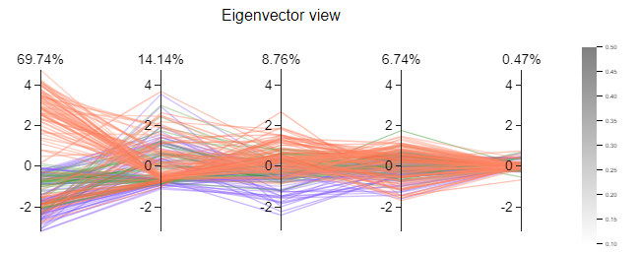
Eigenvector view - parallel coordinator plot
Lib
D3.js - parallel-coordinates(syntagmatic) & Mostapha Sadeghipour Roudsari
Data
PCA.explained_variance_ratio
Encodings
Coordinator: ratio
Line: eigenvector for each data item
Color: latency/ time (user can choose) – gradient colorscale
Time period selected – discrete color to represent different time period
Interactions
Brush on dimension
Click on single data item – find outlier
Hover
Linked with other views
Select which attribute to be represented by color
Notes:
Eigenvector view uses PCA explained_variance_ratio. The coordinator is ratio, which is in order. Each coordinator is in common scale. Each line represent eigenvector for each data item. It has same color encoding and same interactions with data view so I won’t repeat here.
This plot tries to explain how to get the principle components in detail. So it’s important for PCA visualization.

Slide 12
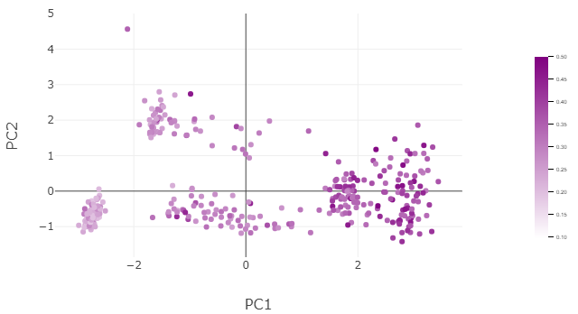
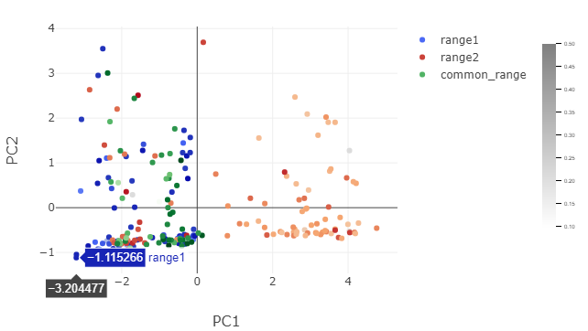
Projection view – scatter plot
Lib
Plotly.js
Data
PCA first 2 principle components projection
Encodings
Xaxis: PC1
Yaxis: PC2
Color: time period selected
Illumination: latency/time (can switch)
Opacity: highlight or not (by parallel plots)
Interactions
Zoom
Notes:
The projection view uses a scatter plot to show the 2 dimension PCA project result. I draw it because it’s the most direct result we get from PCA. User can get the most 2 important composite components which describe the high dimensional dataset best. Scatter plot provides a clear view on the projection.
Xaxis is PC1 value and yaxis is PC2 value. Color represents time period selected by user in the linechart. The illumination in each group represent the latency or time. And if user brush or select data items in parallel coordinator plots, the opacity here will change to show if it is selected.

Slide 13
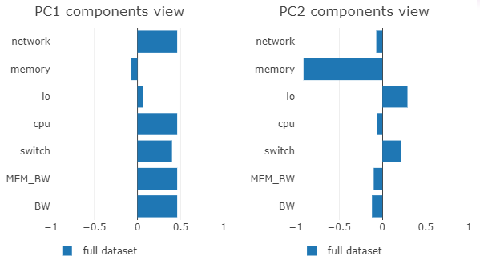
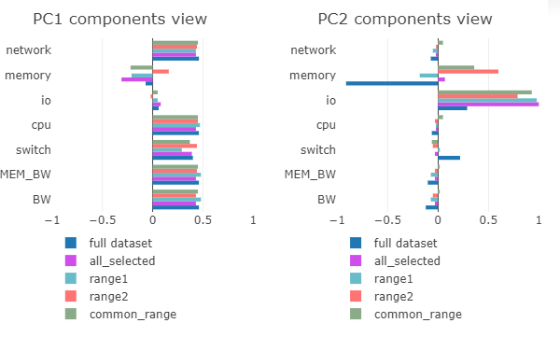
Principle components view – grouped barchart
Lib
Plotly.js
Data
PCA 2 principle components individual loadings(pca.components_)
Encodings
Xaxis: ratio
Yaxis: real attributes(system metrics)
Color: time period selected
Interactions
Select which range to show
Notes:
From PCA we can get principle components which are a linear combination of data attributes. But how can human get the actual meaning of them, like how the principle components are related to the actual attributes? So I plot these two barcharts to show and compare the ratio of actual attributes count in principle component analysis result. Xaxis here is ratio and yaxis is actual attributes. If the bar directs to left , it shows a negative correlation. The longer the bar is , the larger the ratio is. To make comparison between selected time ranges and full dataset, I plot them as grouped barchart. To make the plot looks simple, I take advantage of the plotly library, user can select on the legend to determine which ranges to show. Comparing ratio of actual attributes allows people to observe the change in principle components better.

Slide 14
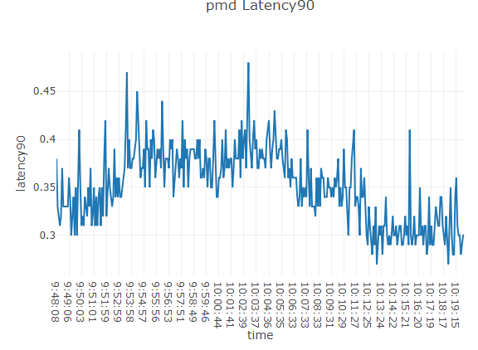
What we get from these visualizations
Take ‘pmd’ data as an example
Notes:
We can see at the beginning, pmd shows fluctuation and from time 9:53 to 10:05, the performance stays steady. And from 10:06, latency tends to decrease until at 10:13, latency stays steady again at a lower value compared with previous time period.

Slide 15
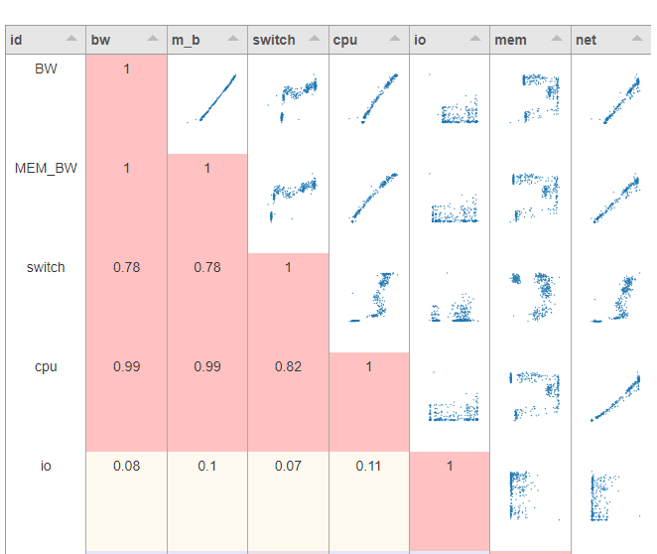
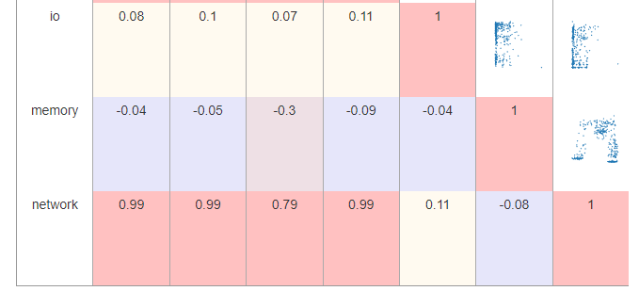
Notes:
For this full dataset we can see there should be a strong positive correlation between cpu percent and bandwidth, network and bandwidth, and cpu percent and network.
While there is negative correlation between context switch and memory.

Slide 16
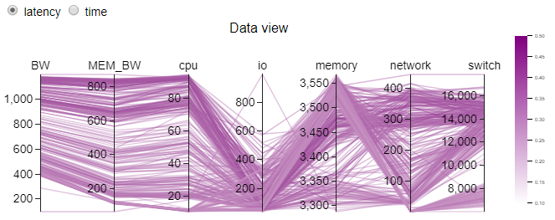
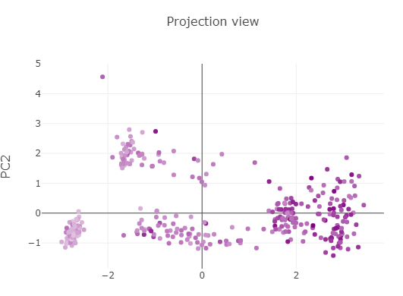
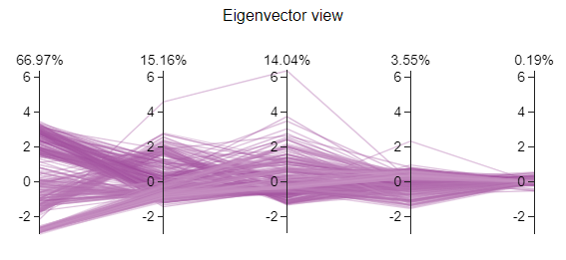
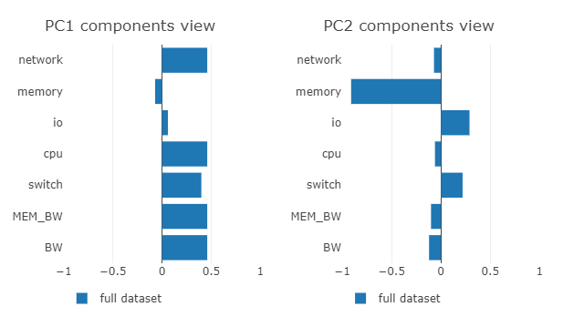
Notes:
We can see, if the color encoding is assigned to latency, data view shows that, high latency record is more possible to have high bandwidth, memory bandwidth, high cpu percent and low io, low memory. If we look back to the correlation view, the correlation view shows the same thing. Then we look at the eigenvector view and projection view, they shows that, pc1 occupies 67% and data items with high latency are projected positive values at pc1. We can see from components view that in pc1, the proportions of network, cpu, switch, memory bandwidth, system bandwidth are almost the same and they count for the majority of the components. This can also be inferred from the data view. Because most of data item seems to have high network, cpu, switch, memory bandwidth, system bandwidth values. Memory has a largest proportion in pc2 and you can see the data distribution in the second coordinator in eigenvector view appears a narrow range, and high memory value in data view. So all these plots conveys the same meanings but focus on different aspect to give the clear insight of data.

Slide 17
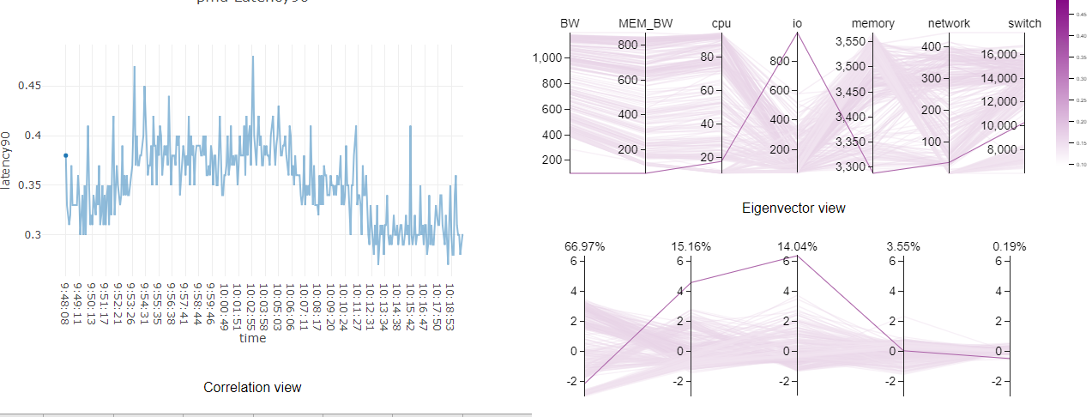
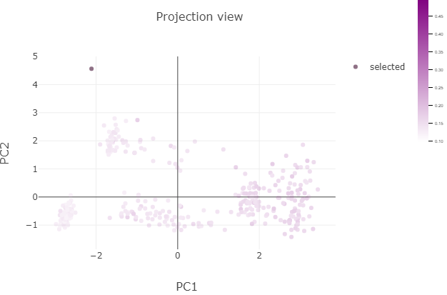
Notes:
We can see these is an outlier line in the parallel coordinator view so we click on it to see what happens. We can see this data item has very low value in each system metrics except io and has a high latency. The PCA projection shows it is also an isolated point. We can see this data item is actually the first data of the full dataset. And that really makes sense because the initial pattern for first few minutes could be potentially off, due to the uneven start of the target application.

Slide 18
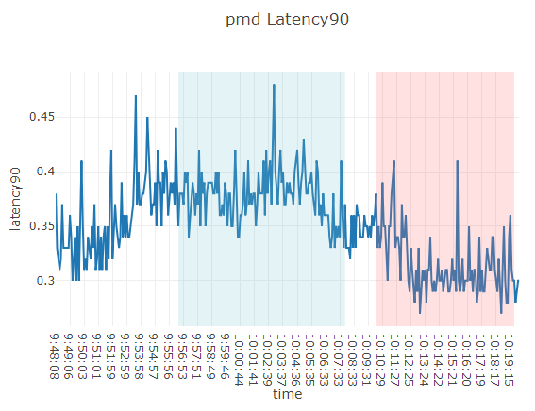
Notes:
So, we can ignore the initial time period. Let’s do comparison on these two time period. The first shows high latency and the lower latency.

Slide 19
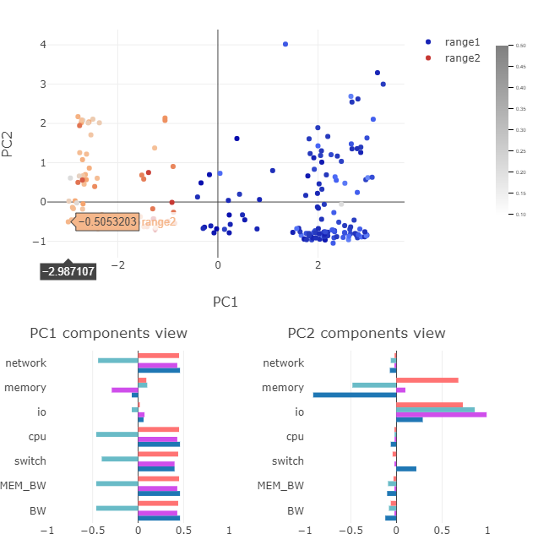
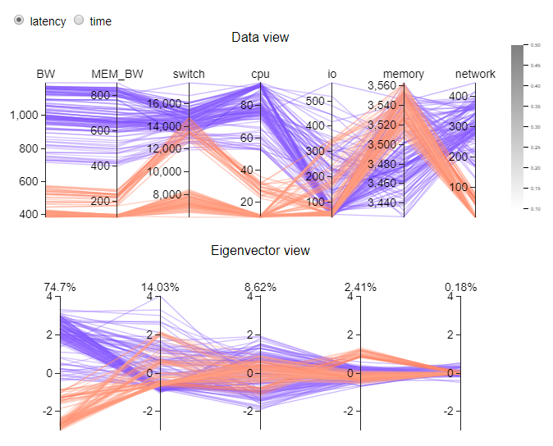

Notes:
Here it is. There are many conclusions can be found here but due to time limit, I may go through some and put the rest into report.
The blue means the first time period with high latency and the red means time period the low latency. We can see the there is huge difference between the two time intervals in pc1 and actual attributes values. See the data view, High latency shows low memory ,so maybe memory is a bottleneck for pmd execution. And we can see the pc2 components view proves that.

Slide 20
Demo

